Slide 1
Brothers of the Christian Schools
Postulator General

Slide 2
Brother
James Miller (1944 - 1982)
EARLY CHILDHOOD
INTELLECTUAL AND RELIGIOUS FORMATION
TEACHER
MISSIONARY
THE MARTYRDOM
CAUSE OF BEATIFICATION

Slide 3
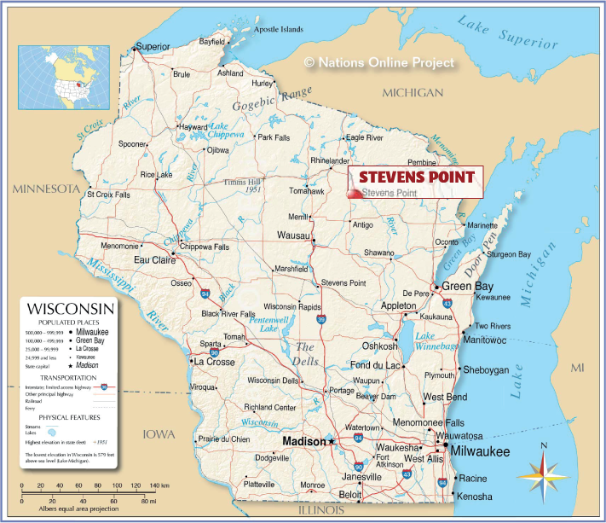
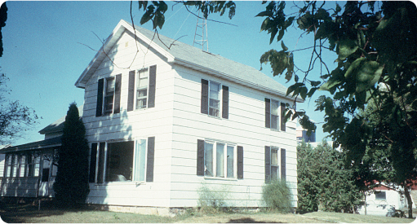
Wisconsin
Early childhood
He was born on September 21 1944 at Ellis (Stevens Point), Wisconsin, USA
1958: he attended Pacelli High School in Stevens Point, directed by the Brothers of the Christian Schools.
1944
1950-1957
1958
1950-1957: he went to Edison,
a public school in Ellis.

Slide 4
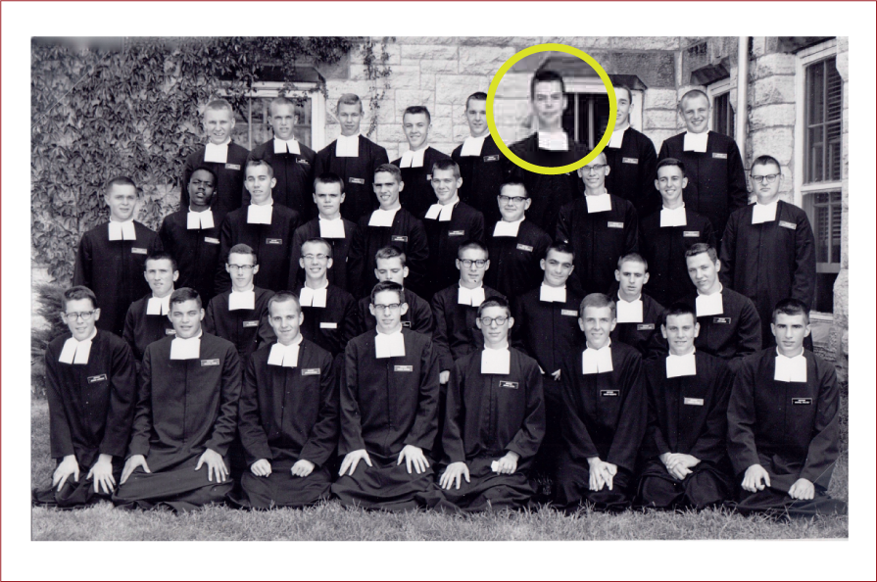
Intellectual and Religious Formation
August 31, 1963: he took first Vows and began the Scolasticate in Winona, where attended the Saint Mary’s University.
1963
1959
In 1959 he joined the Brothers of the Christian Schools at the Junior Novitiate in Glencoe (Illinois).

Slide 5
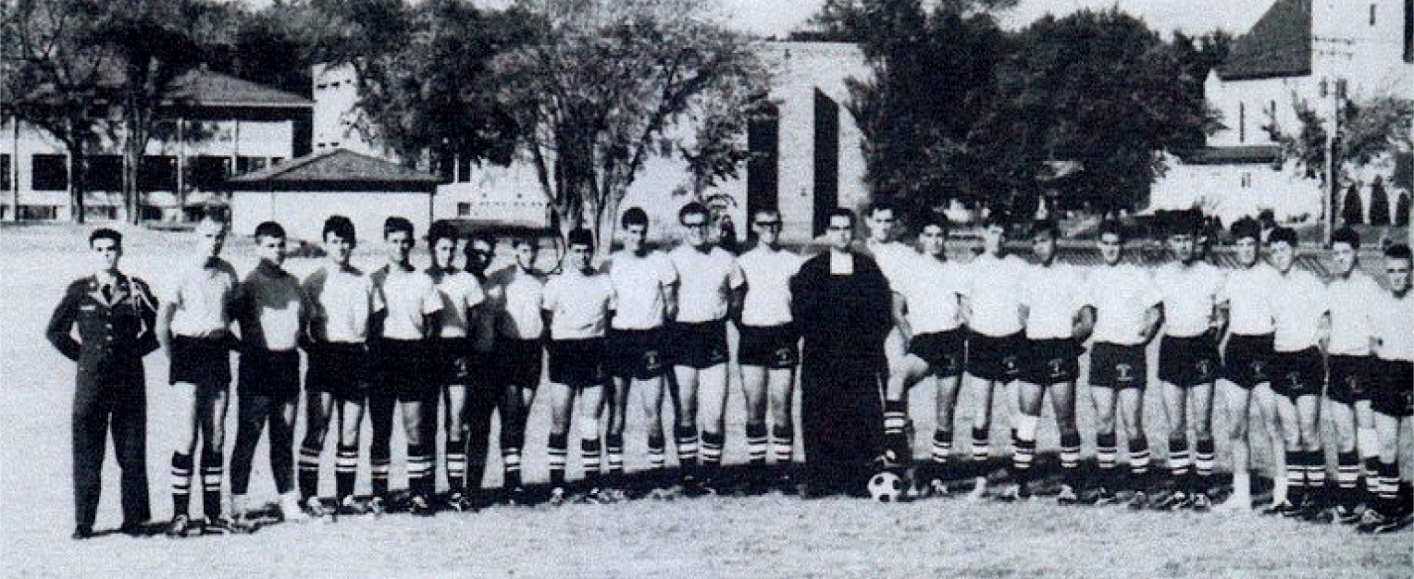
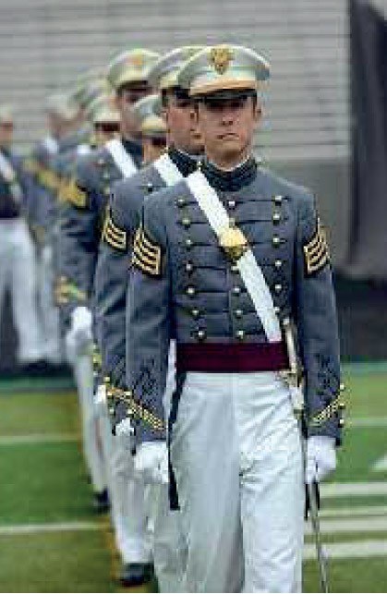
Saint Paul, MN
Teacher
1967-1969 CRETIN HIGH SCHOOL
A “Military Academy”, with a JROTIC (Junior Reserve Officers’ Training Corps) program. Br. James was appointed as “Quartermaster”

Slide 6
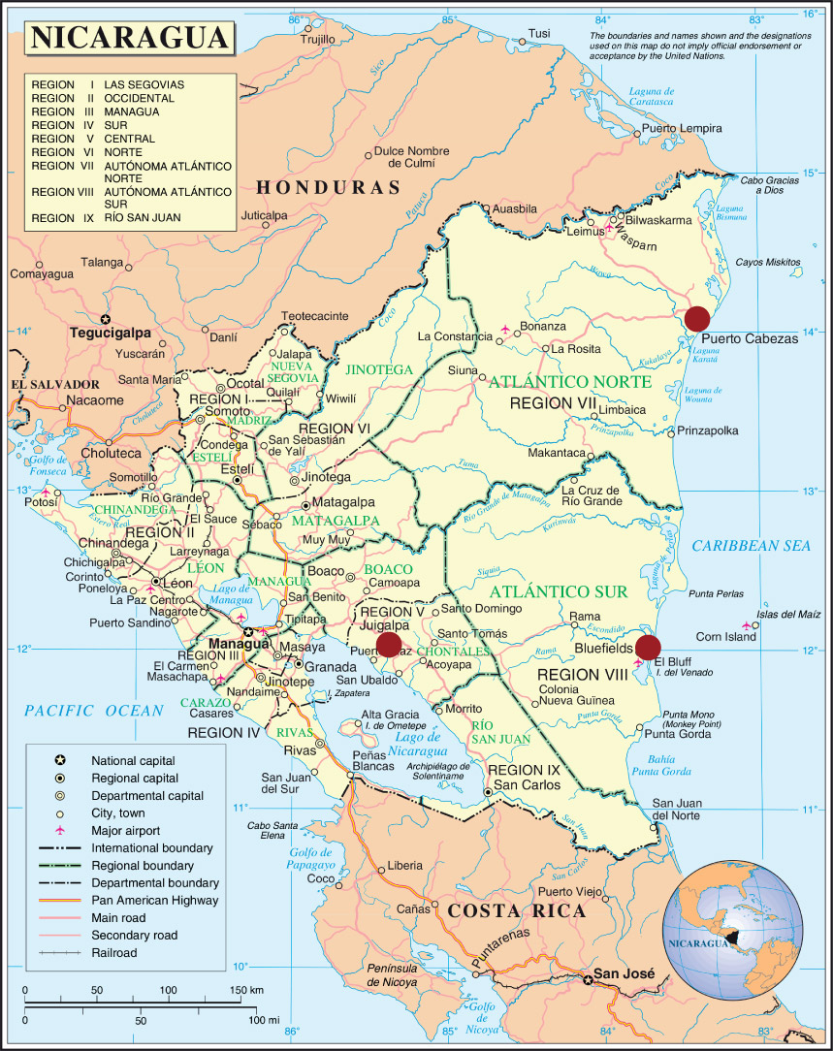
Missionary
Nicaragua
In 1969 he requests to go to the missions.
He was appointed to at BLUEFIELDS
(1969 – 1975) and after toPUERTO CABEZAS
(1975 - 1979)
Lasallian institutions of the District of Winiona (USA) in Nicaragua in the eighties:
BLUEFIELD: Colegio San Josè
PUERTO CABEZAS: Colegio Nacional Bartolomè Colón
WASPAM: Istituto La Salle

Slide 7
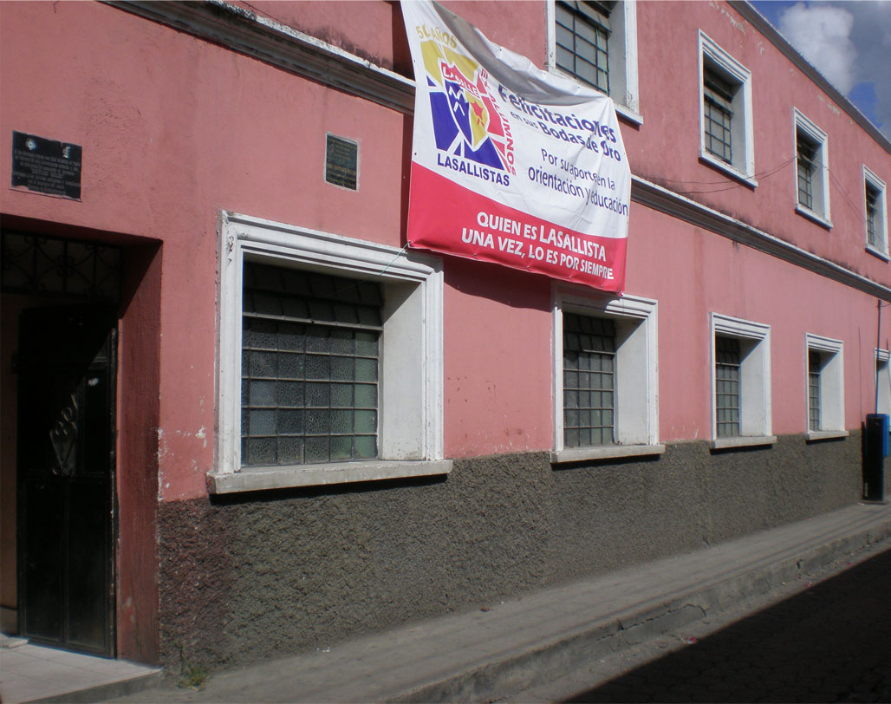
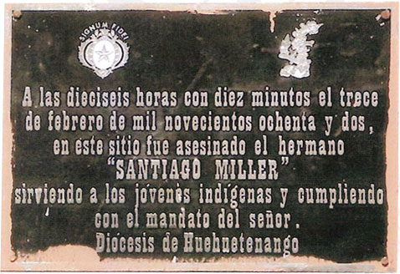
The Martyrdom
Guatemala
On January 1981 he was assigned to
Huehuetenango at
CENTRO INDIGENA LA SALLE
The Reception Centre, which counted from 120 to 150 young people indigenous people who received education
and were sent to work.
Here he will be murdered on February 13, 1982

Slide 8
The Martyrdom
Why Brother James was murdered and why he is considered a “Martyr”
The great hostility and the bloody persecution of the government of Guatemala against the Church, who, in the name of Christ, defended the rights of the poor and of the indigenous, unjustly banished from their lands, persecuted and killed.
The “odium fidei ex parte persecutoris”, requested for the canonical recognition of martyrdom, is that granted to those who work in the name of their faith.
The Brothers of the Christian Schools had some institutions where they exclusively admitted indigenous boys. Brother James was subdirector of the “Casa Indígena La Salle” in Huehuetenango.
The ”acceptatio martyrii ex parte Servi Dei”. When Brother James was back in the States for knee surgery, his relatives and some Brothers implored him not to go back to Guatemala, since the situation was very dangerous. But he went!

Slide 9
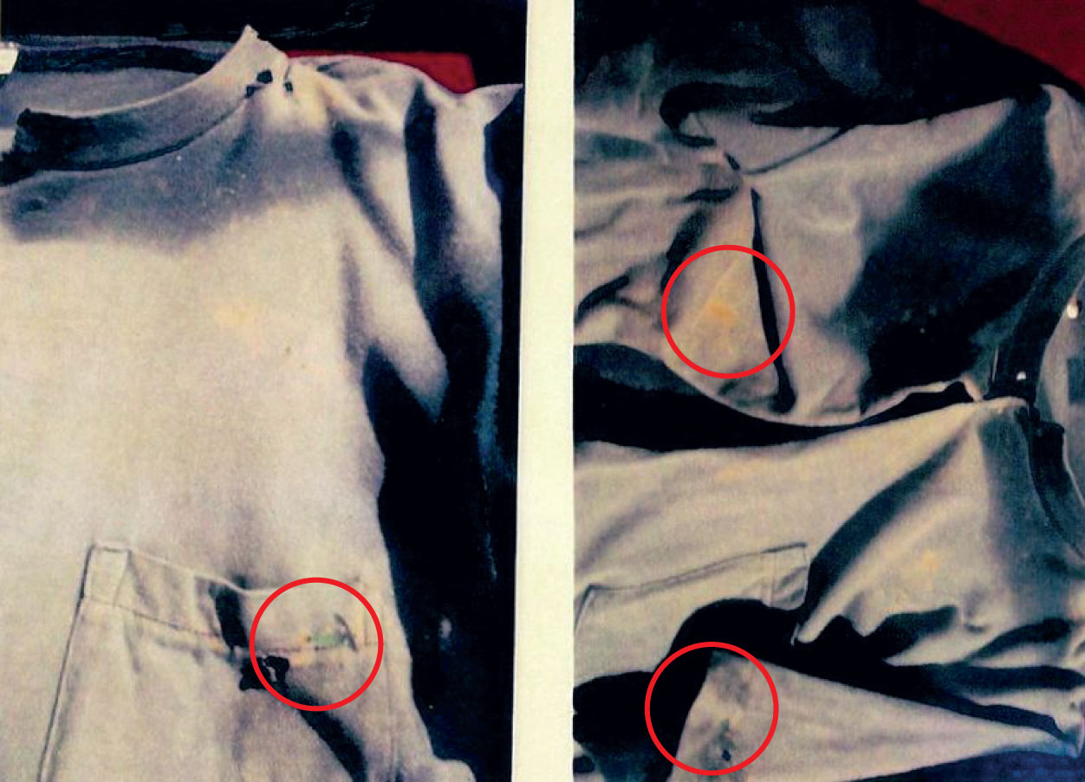
The Martyrdom
The overalls of Br. James with the bullet holes

Slide 10
Cause of Beatification
The canonical process 1st part
Began on september 1, 2009 by the Diocese of Huehuetenango, where Brother James died with the "reputation of Martyr".
With the beginning of the diocesan inquiry Brother James received the title od SERVANT OF GOD
The aim of the diocesan inquiry is to collect documents and testimonies
The luminous path of the martyrdom of Br. James Miller

Slide 11
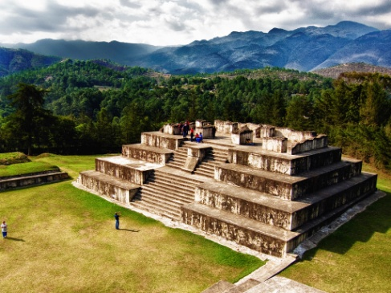
The town of
HUEHUETENANGO
The archeological site of the Maya civilization at Zaculeu
Guatemala

Slide 12
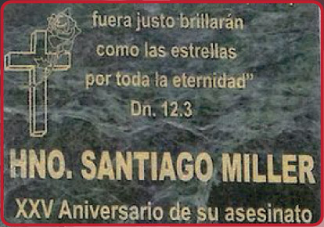
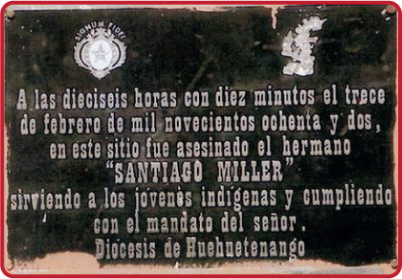
Cause of Beatification
Casa Indígena La Salle
was the Community of Brother James in Huehuetenango
After his “martyrdom” the name was changed in Centro Indígena Santiago Miller

Slide 13
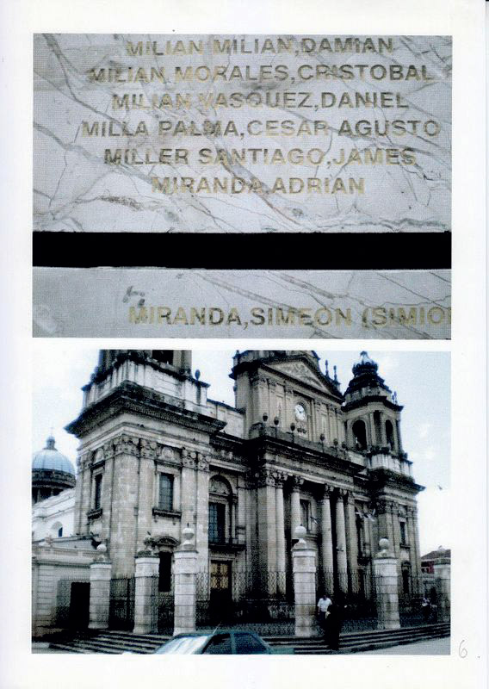
Cause of Beatification
Cathedral of Guatemala City
On one of the external pillars, among the other names, is that of Br. Miller Santiago, James

Slide 14
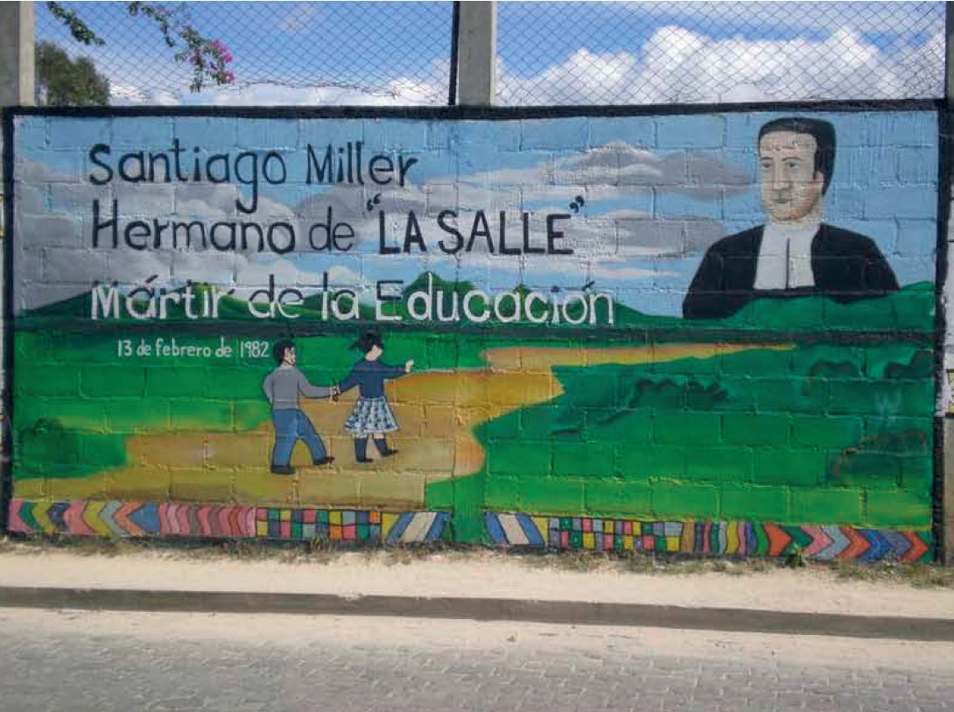
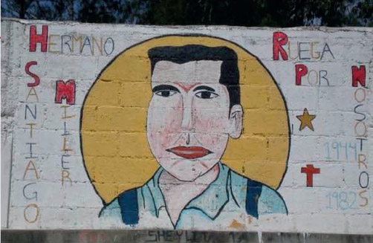
Cause of Beatification
Guatemala City
Some murals dedicated
to Brother James "Santiago" Miller

Slide 15
Cause of Beatification

Slide 16
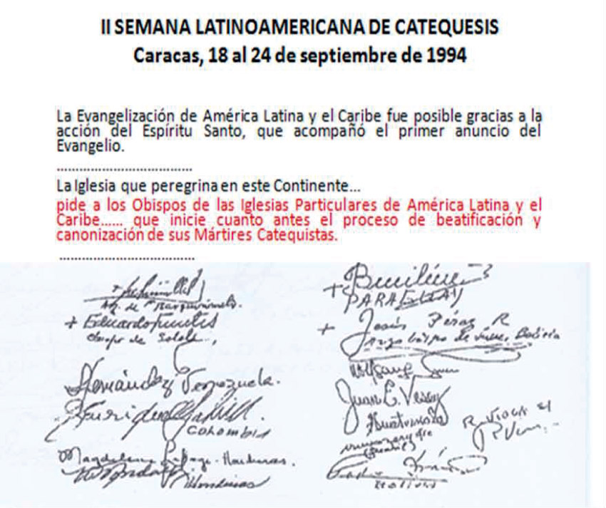
Cause of Beatification
The canonical process
September 24, 1994 Latinamerican Bishops’ Conference requests to begin in the dioceses the Processes for the Beatification of the Martyrs
The luminous path of the martyrdom of Br. James Miller

Slide 17
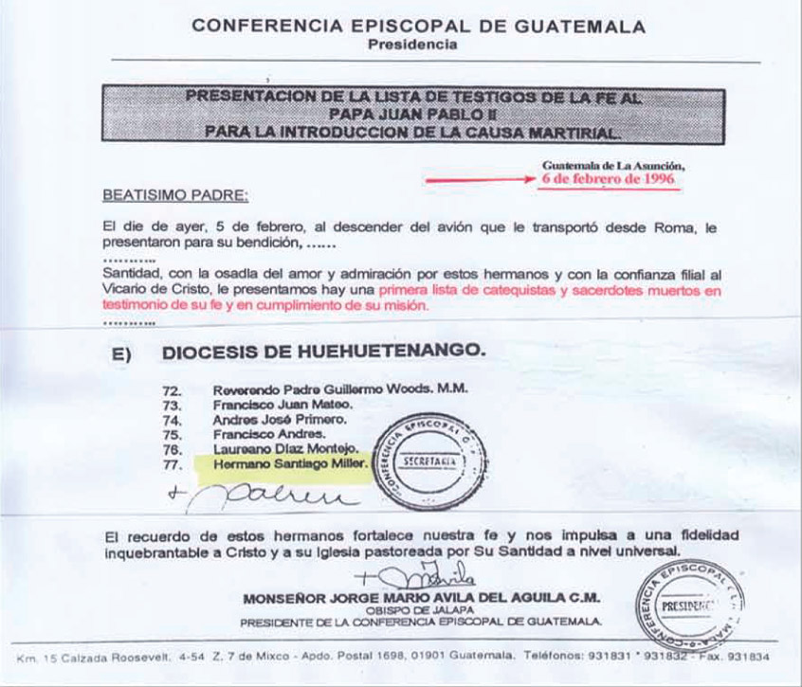
Cause of Beatification
The canonical process
February 6, 1996 Request of the Bishops’ Conference of Guatemalato Pope John Paul II for the Beatification of 77 Martyrs
The luminous path of the martyrdom of Br. James Miller

Slide 18
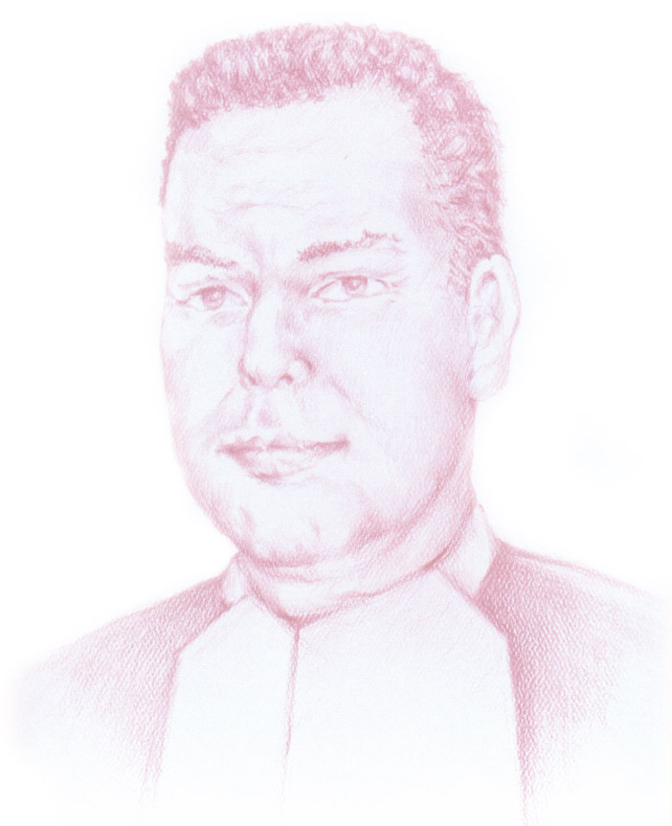
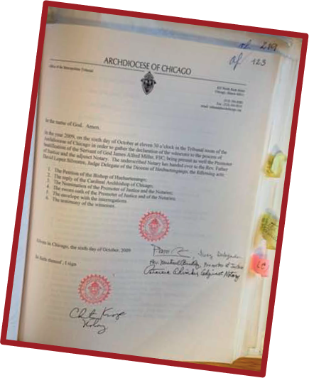
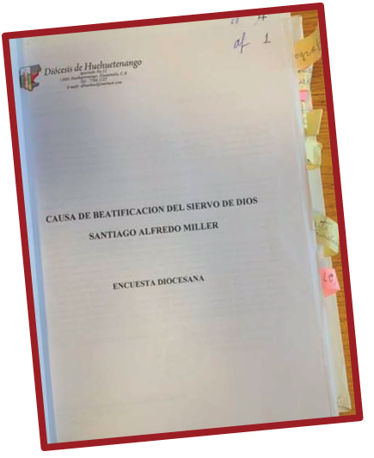
Cause of Beatification
The canonical process
Semptember 1, 2009
The Cause of Beatification begins and
Brother
JAMES MILLER
becomes
Servant of God
The luminous path of the martyrdom of Br. James Miller

Slide 19
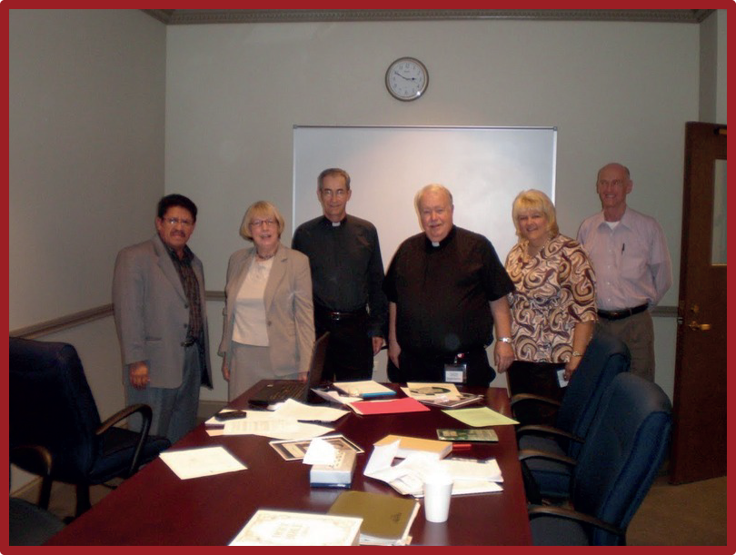
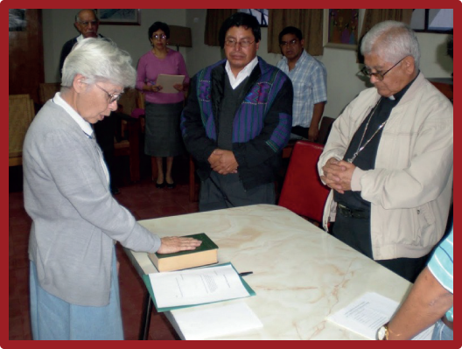
Cause of Beatification
The canonical process
October 5, 2009 The members of the Diocesan Tribunal in Chicago
September 8, 2009 Sister MADELEVA Manzanares Suazo takes the oath in the presence of the Bishop, the Promoter of Justice and the Notary.
The luminous path of the martyrdom of Br. James Miller

Slide 20
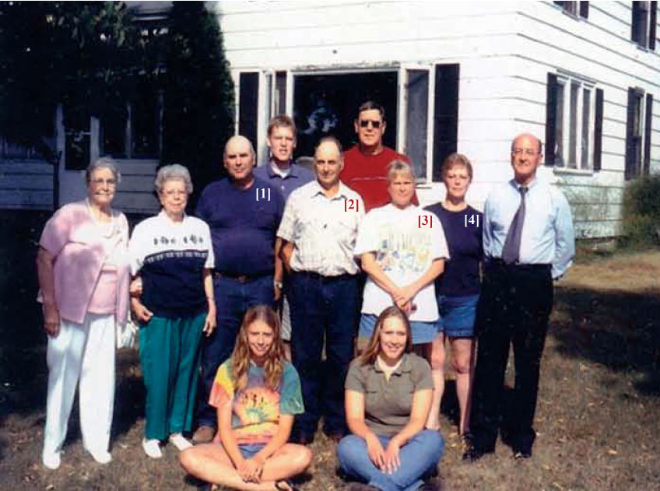
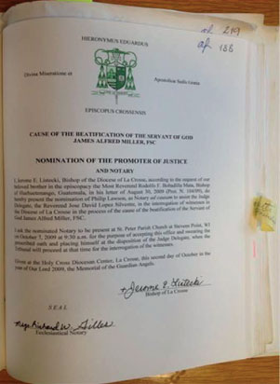
Cause of Beatification
The canonical process
Process in the Diocese of La Crosse (the diocese where James Miller was born)
4 witnesses William Miller and Ralph Miller
Patricia Richter Miller
Louise Shafranski Miller
(2 brothers and 2 sisters of James)
MILLER’S FAMILY in front of their house
The luminous path of the martyrdom of Br. James Miller

Slide 21
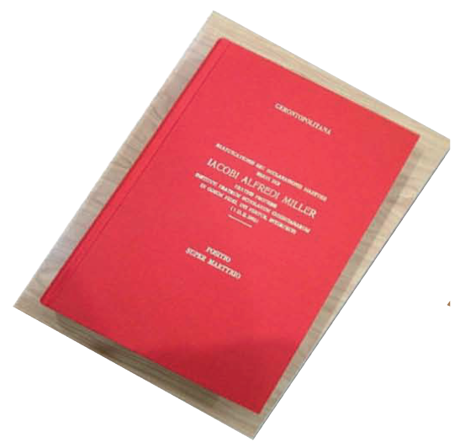
Cause of Beatification
The canonical process 2nd part
POSITIO super martyrio
Servi Dei IACOBI ALFREDI MILLER
520 pages, divise in 7 sections
1. PRESENTATION OF THE RELATORE
2. GENERAL INTRODUCTION
3. INFORMATIO (WITH THE BIOGRAPHY: 7 CHAPTERS)
4. SUMMARIUM TESTIUM (TESTIMONIES)
5. SUMMARIUM DOCUMENTORUM (DOCUMENTS)
6. RELATIO (RELATIONES)
7. ICONOGRAPHY
The luminous path of the martyrdom of Br. James Miller

